Slide 1
ECEN 192 Lab 4
Motors, Actuators, and Sensors

Slide 2
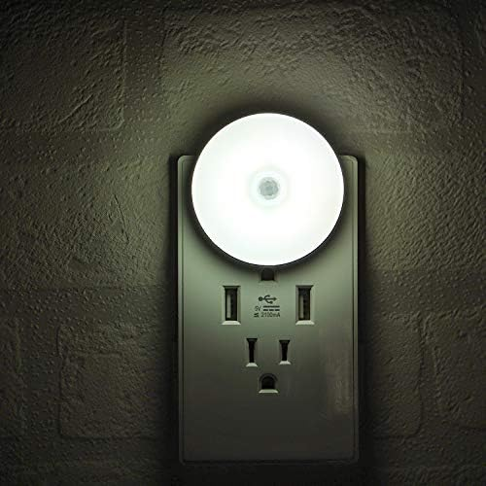

Slide 3
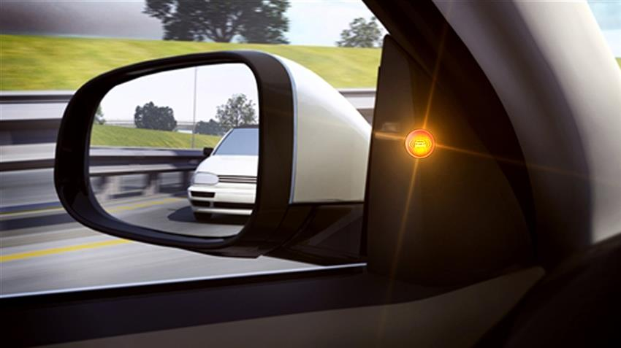

Slide 4
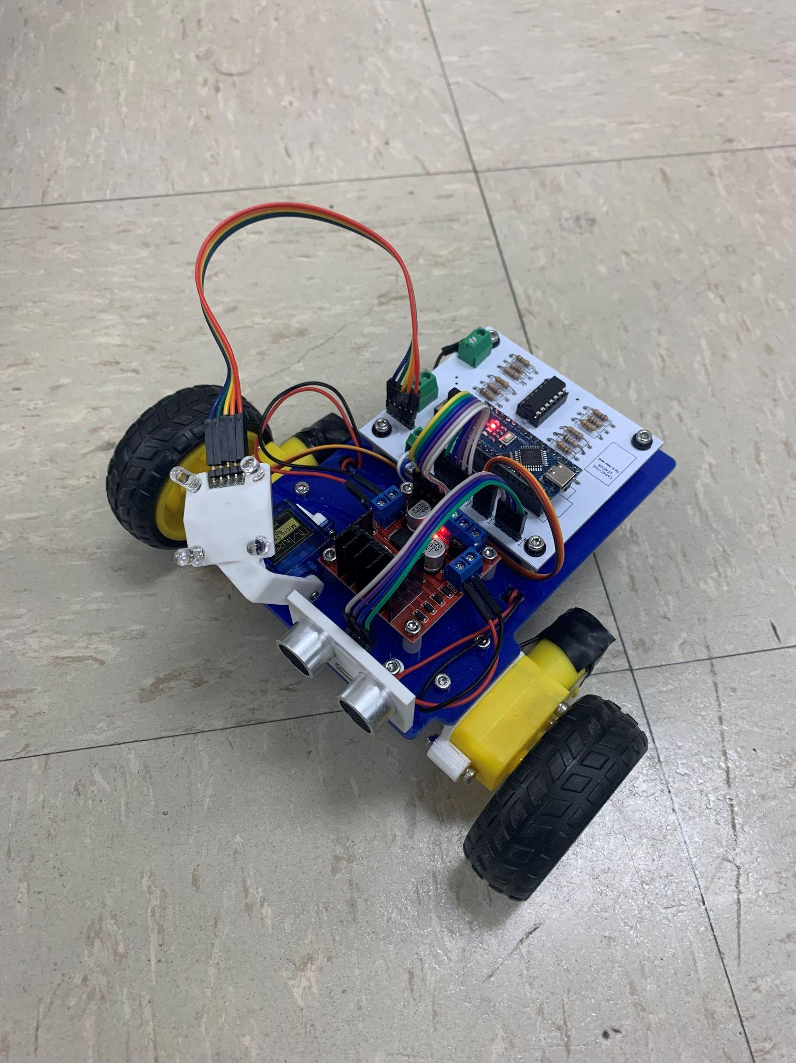

Slide 5
Introduction to components
Motor
Switch
Photoresistor
Transistor

Slide 6
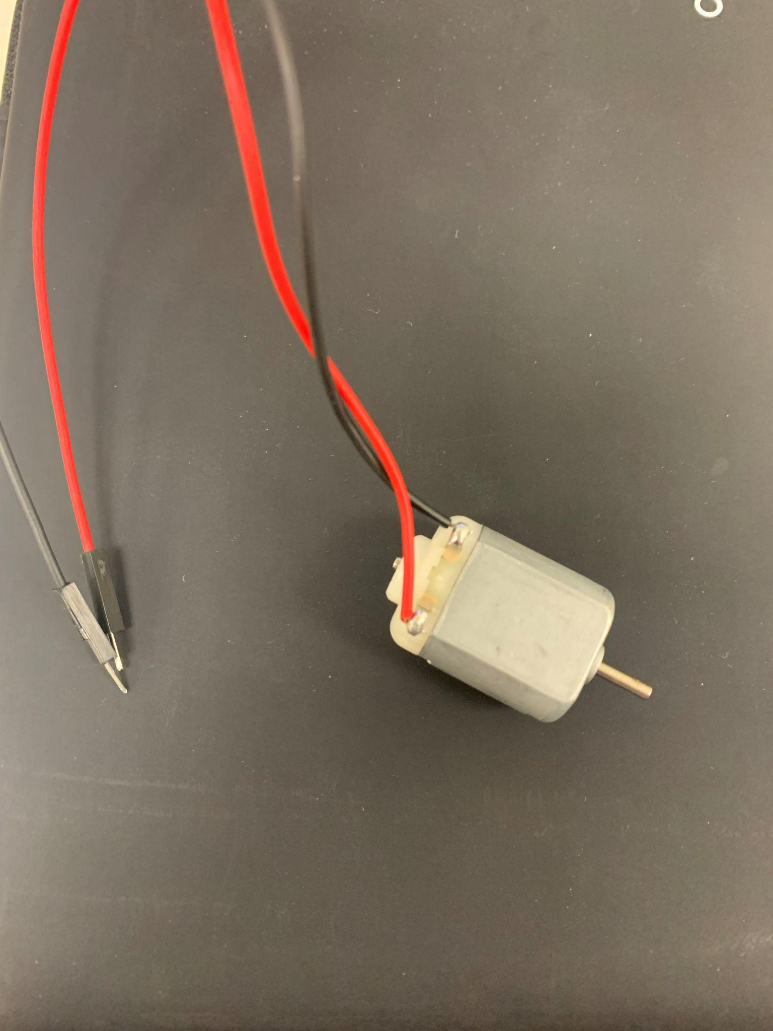
Motors

Slide 7
Motors
Turn on ~ 1V
Maximum Voltage ~ 6V
can handle 9V for short periods of time
Internal Resistance: ~3 Ohms
Speed (with no load)
3V: 7900 RPM (23mA)
6V: 15500 RPM (36mA)

Slide 8
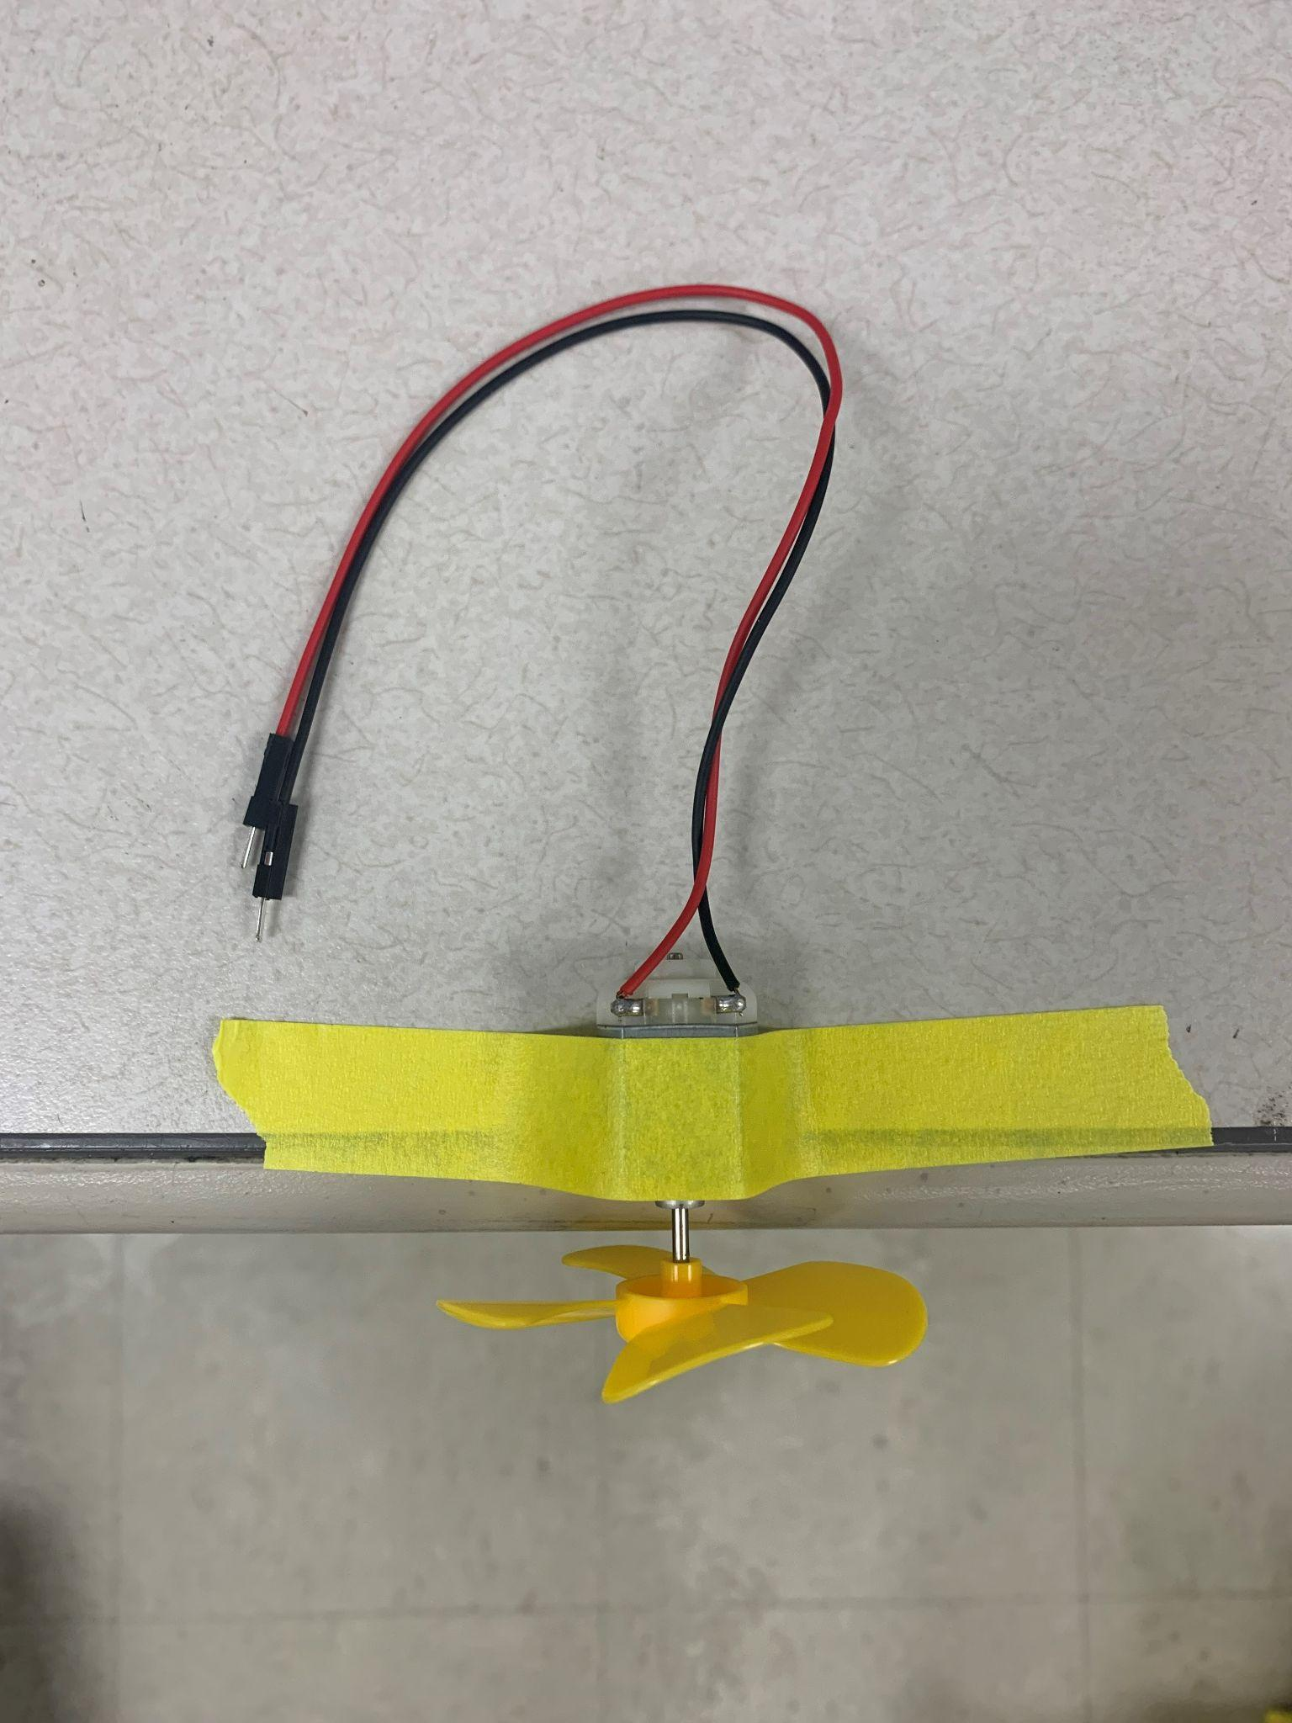
Tape this on your desk

Slide 9
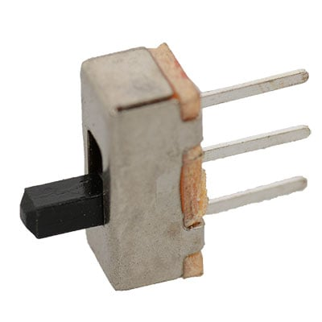
Switches

Slide 10
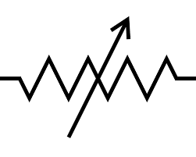
Photoresistor
As light increases, resistance decreases
~20 Kohm
~2 Kohm
~100 ohm

Slide 11
The photorestor in its natural habitat

Slide 12
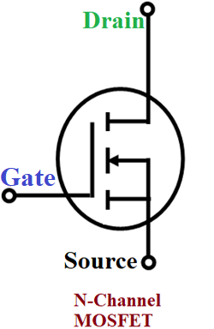
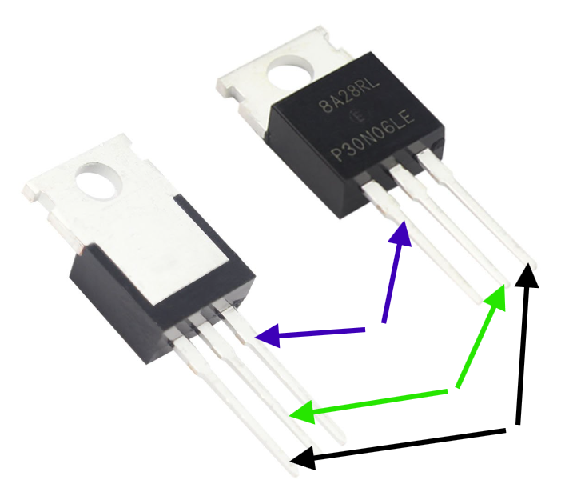
Transistor

Slide 14
Transistor

Slide 15
Transistor
Transistors are easier to control than motors, so we will use this with our photoresistor to allow more precise motor control
Gate (left pin): node whose voltage controls if the MOSFET allows current or not
Drain (middle pin): where the electrons flow to or “drain” to
Source (right pin): “source” of electrons

Slide 16
3 circuits
Turn on motor with a switch
Turn on motor with a light sensor
Control motor with a potentiometer

Slide 17
Turn on motor with a switch

Slide 18
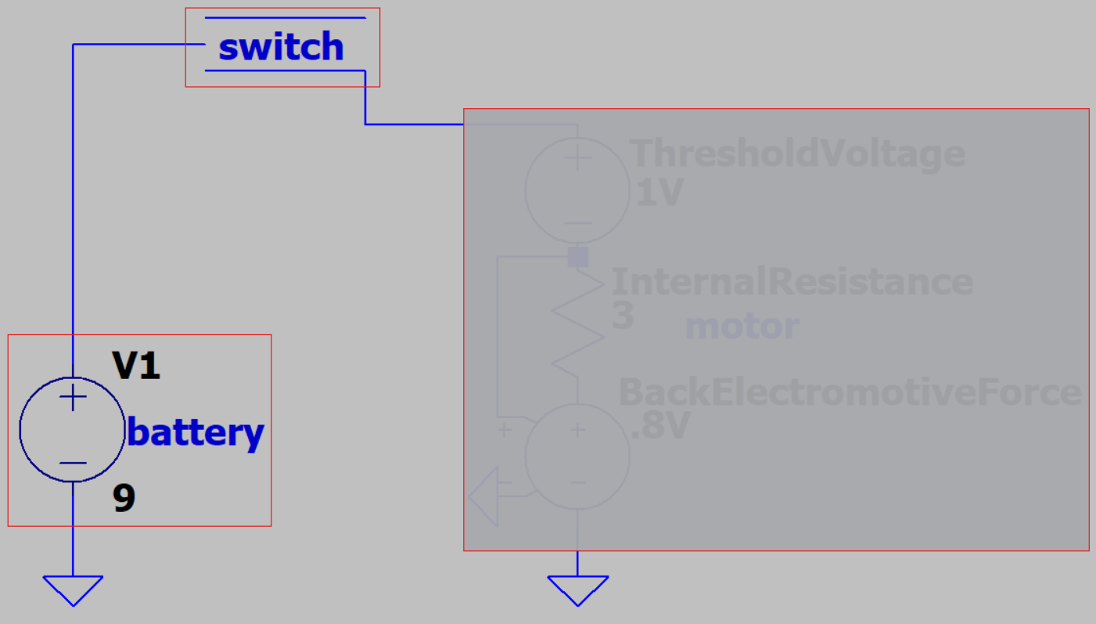
Turn on motor with a switch
Red boxes are components
Use jumper wires for connections
Motor goes here:
Simulation details
in Appendix A

Slide 19
Turn on motor with a light sensor

Slide 20
Turn on motor with a light sensor
WARNING:
Be cautious of burning your fingers on the transistor.

Slide 21
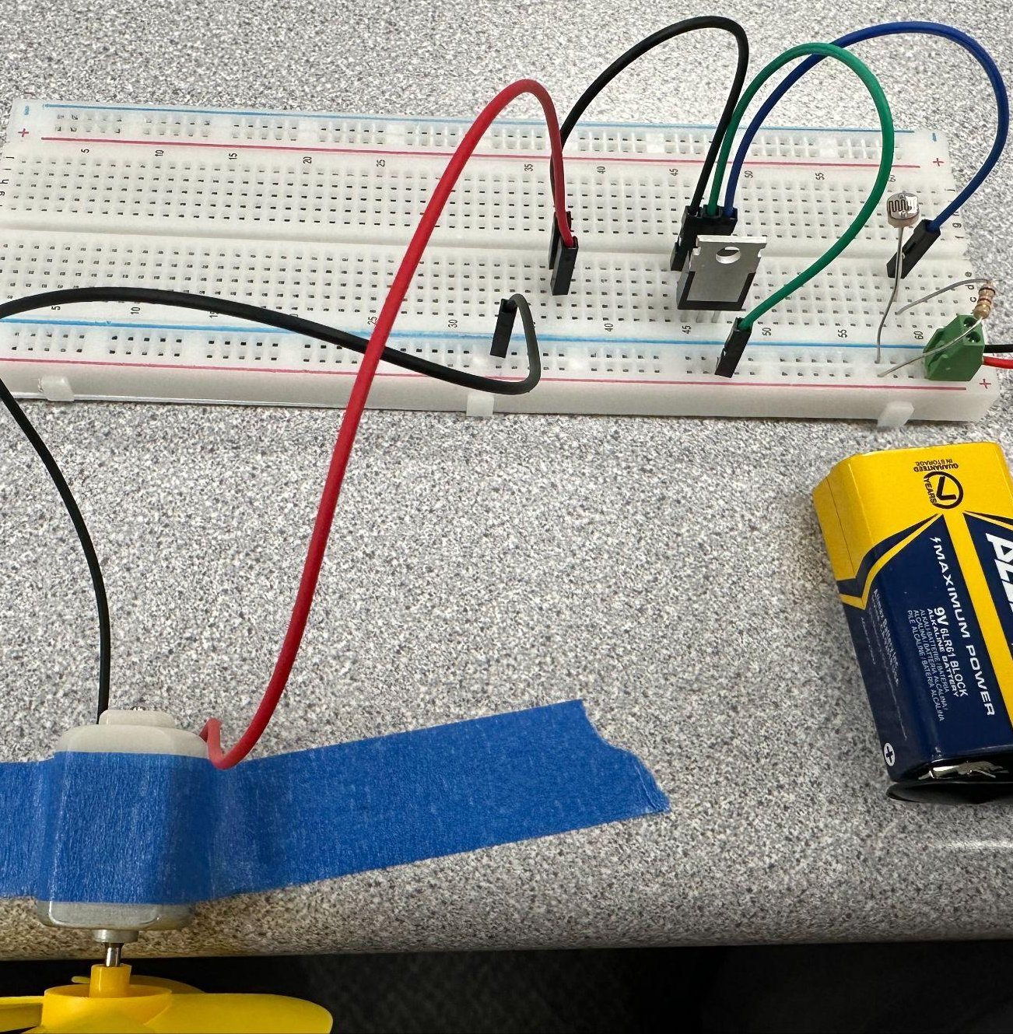
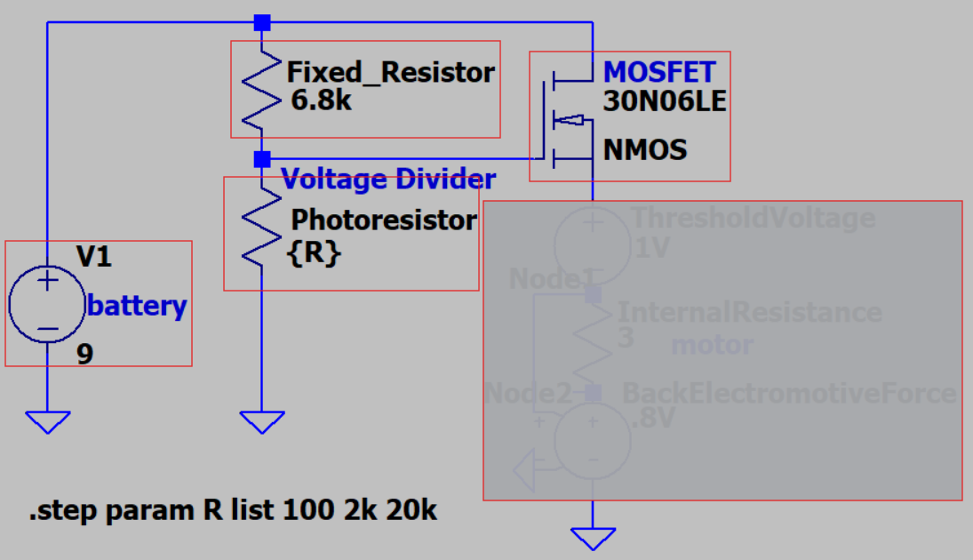
Turn on motor with a light sensor
Be careful about the connections and pay attention to the color code since the schematic has a different pin order than the actual chip
Motor goes here:
Simulation details
in Appendix A

Slide 22
Photoresistor Circuit Alternative View
The circuit is the same one shown on the previous slide, just from a different perspective.
Note: the blue, green, and black jumper wires to the MOSFET are consistent with the color coding from the schematic.

Slide 23
Turn on motor with a potentiometer

Slide 24
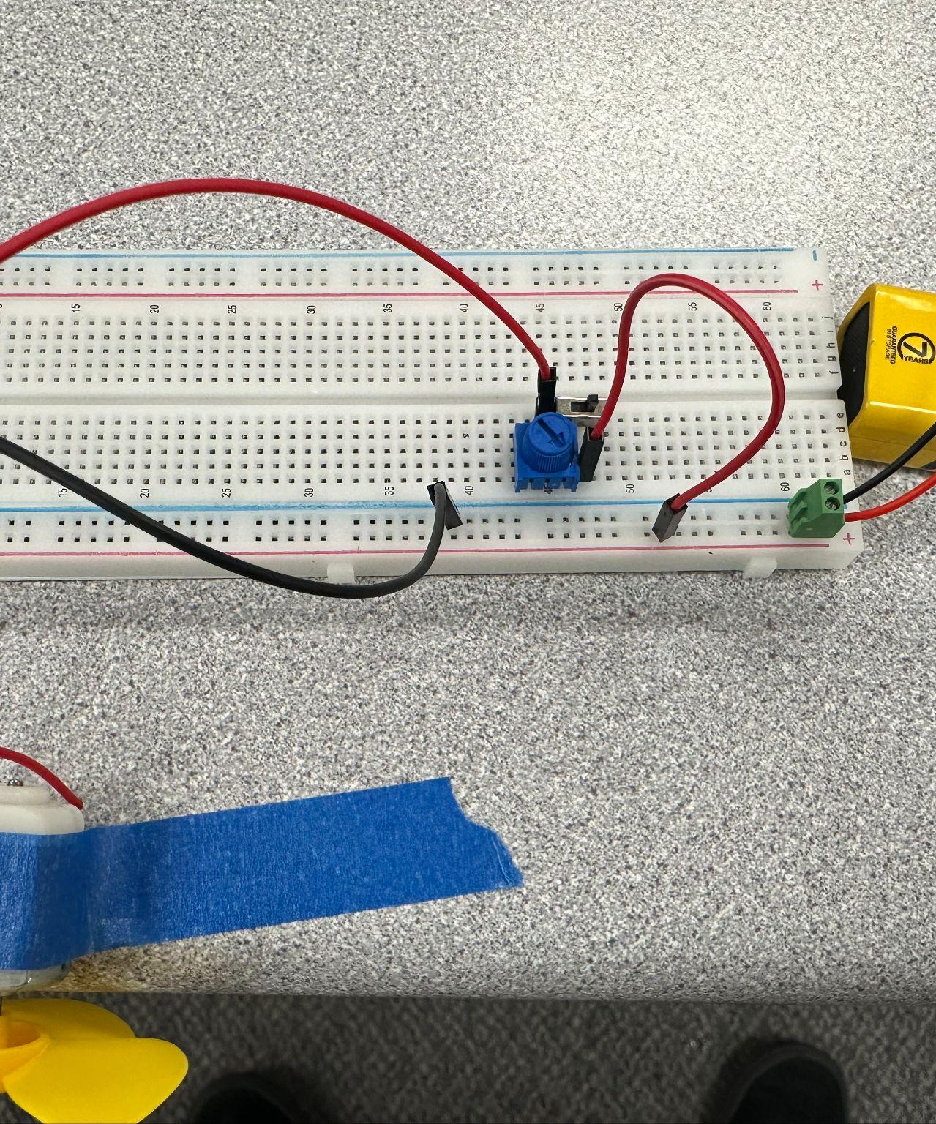
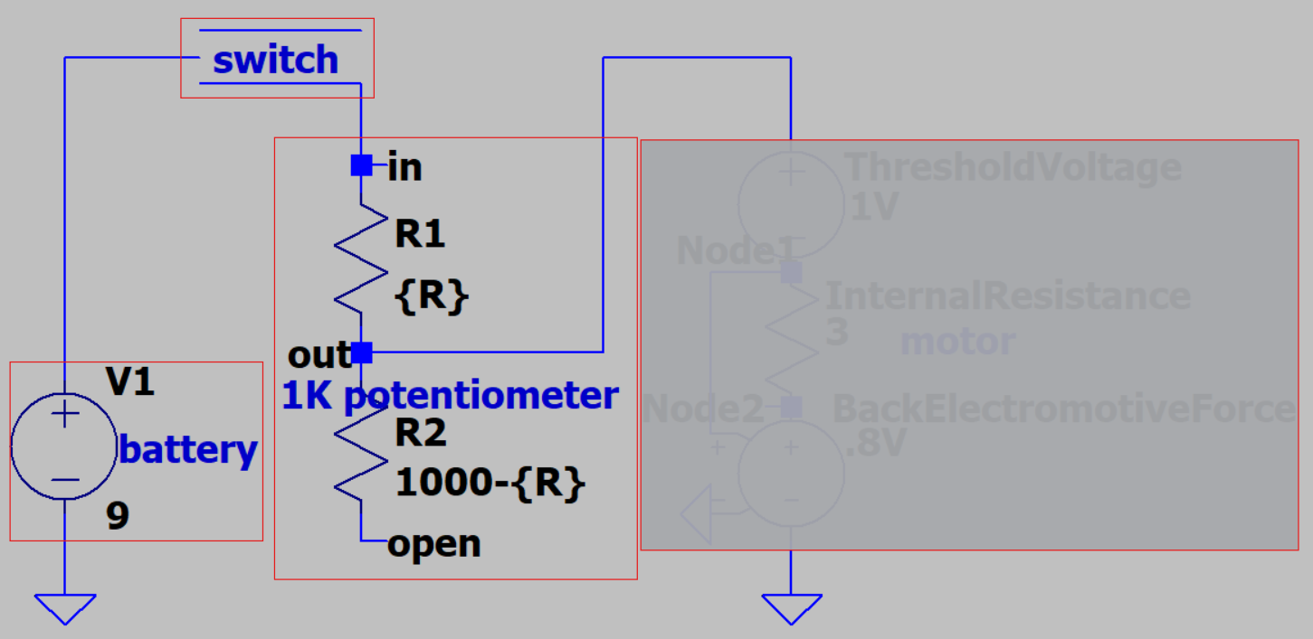
Same circuit as before but wired through one half of our potentiometer
Motor goes here:
Simulation details
in Appendix A

Slide 25
Appendix

Slide 26
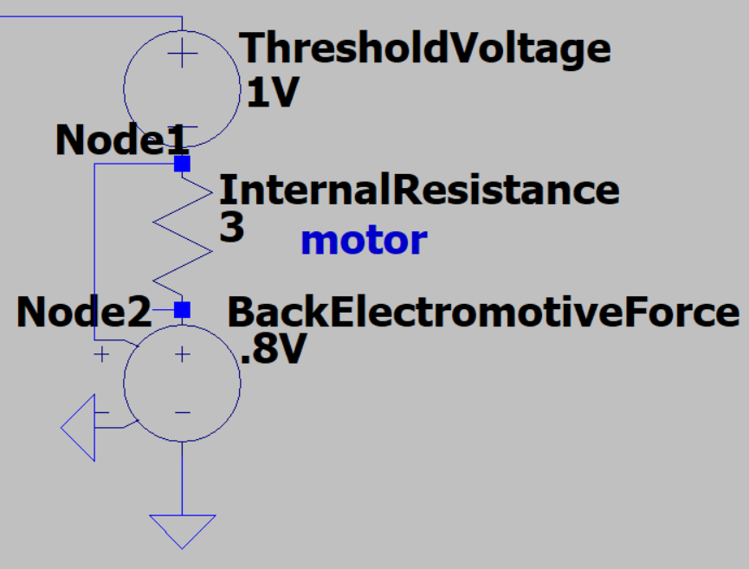
Appendix A – Motor Function
Back EMF stands for back electromotive force, which is a result of the motor translating electrical power to rotational motion. It is measured in volts and can be modeled as a fraction of the applied voltage across the motor (voltage*0.8).
Once the threshold voltage is reached, the motor dissipates power through motion (Back EMF) and kinetic friction (Internal Resistance). The low internal resistance (3 ohms) and high ratio for back EMF suggests an efficient motor.
One drawback of the low internal resistance is that the motor does not function well in series with other resistive elements (hence the need of our amplifier in the last circuit)
According to our simulation in LTspice (software you will become familiar with), our design simple switch design drops 1 volt to overcome static friction (threshold voltage) 1.6 volts to internal resistance (volts of node1- volts of node2), and 6.4 volts to rotational motion.

Slide 27
Appendix B – Photoresistor Response
https://www.tme.eu/Document/0b7aec6d26675b47f9e54d893cd4521b/PGM5506.pdf
The light dependent resistor (LDR or photoresistor) we use has a nonlinear response to light. The datasheet gives data for 10 Lux, whereas the rooms we usually are in are ~20 Lux. The values given in the lab specs are experimental values measured in realistic conditions during lab development.

Slide 28
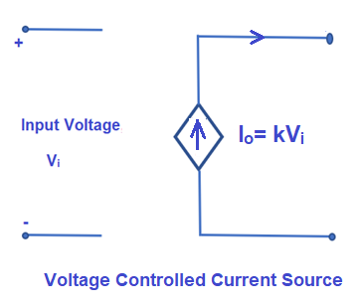
Appendix C – Simple MOSFET Explanation
https://www.mouser.com/datasheet/2/308/rfp30n06le-1195941.pdf
While the above datasheet is the official one, the most relevant way to describe this is the explain a voltage controlled current source.
Since our motor has low internal resistance, we need the component in series with it to go to zero resistance, which allows us to get the greatest voltage across our motor (and thus higher back EMF). MOSFETs, such as the 30n06le, are the easiest way to accomplish this.
With this configuration we can turn our motor on with a parallel voltage divider that changes with light (due to our LDR) and have current flow freely through the motor. This does mean the potentiometer setup is not optimal, but hey, it’s a beginner circuit. You will get to know MOSFETs very well junior year.

