Slide 1
Component Exploration
ECEN 192
Notes:
Make another powerpoint that’s is formatted for a middle schooler. Try no words, just pictures (at first).

Slide 2
Resistors
Less Resistance
More Resistance
Resistor
Symbol
Notes:
Replace the text with powerpoint text.

Slide 3
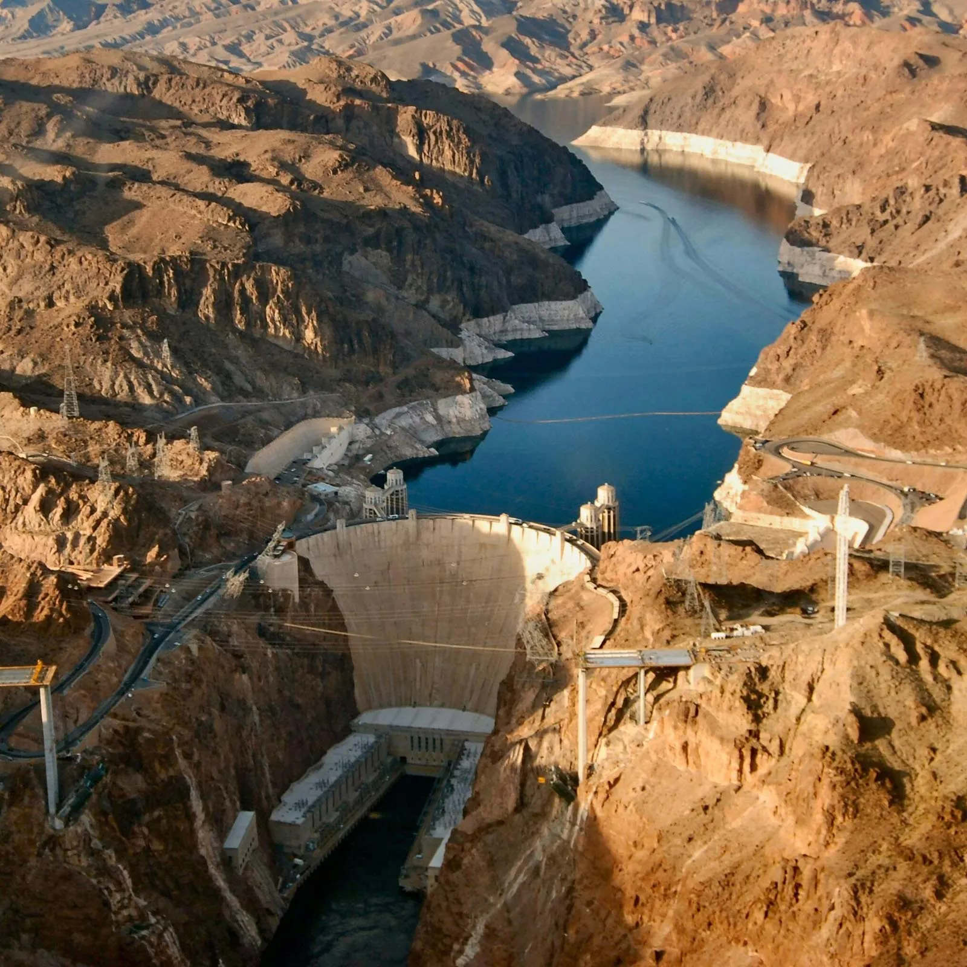
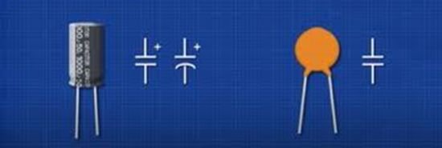
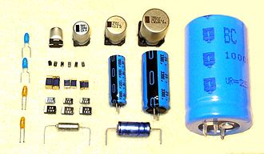
Capacitors
Polarized Capacitor
Non-Polarized Capacitor
Notes:
Can you find a picture of a dam?

Slide 4
Diode
Forward Biased
Reverse Biased
Anode
Bias spring
+12V
+12V
Diode
Current Flow
Symbol
Block
0V
0V
Cathode
Notes:
I like this example, but can we make the image simpler?

Slide 5
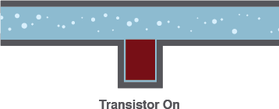
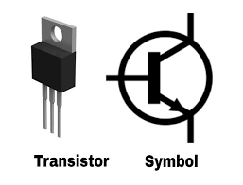
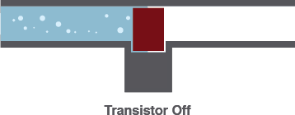
Transistor
Transistor On
Transistor
Symbol
Transistor Off
Notes:
Good. Make text pixelation proof.

Slide 6
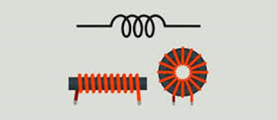
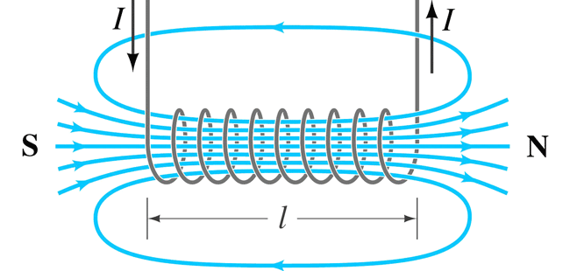
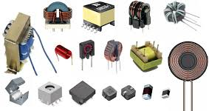
Inductors
Symbol
Inductor
Magnetic Field
Circuit
Notes:
Try explaining with electricity rather than water. Maybe have this be the last component we explain.

Slide 7
Op Amp and IC
Notes:
I’m fine with this.

Slide 8
Standard PCB Reference Designations
Designator | Component
R | Resistor
C | Capacitor
L | Inductor
T | Transformer
D | Diode
Q | Transistor
U, IC | Integrated Chip
SW | Switch
Q1
D3
Q2
R9
R7
R11
R5
Notes:
Show picture of our board. Have big fat red arrows pointing to examples. Turn this slide into a reference table.

Slide 9
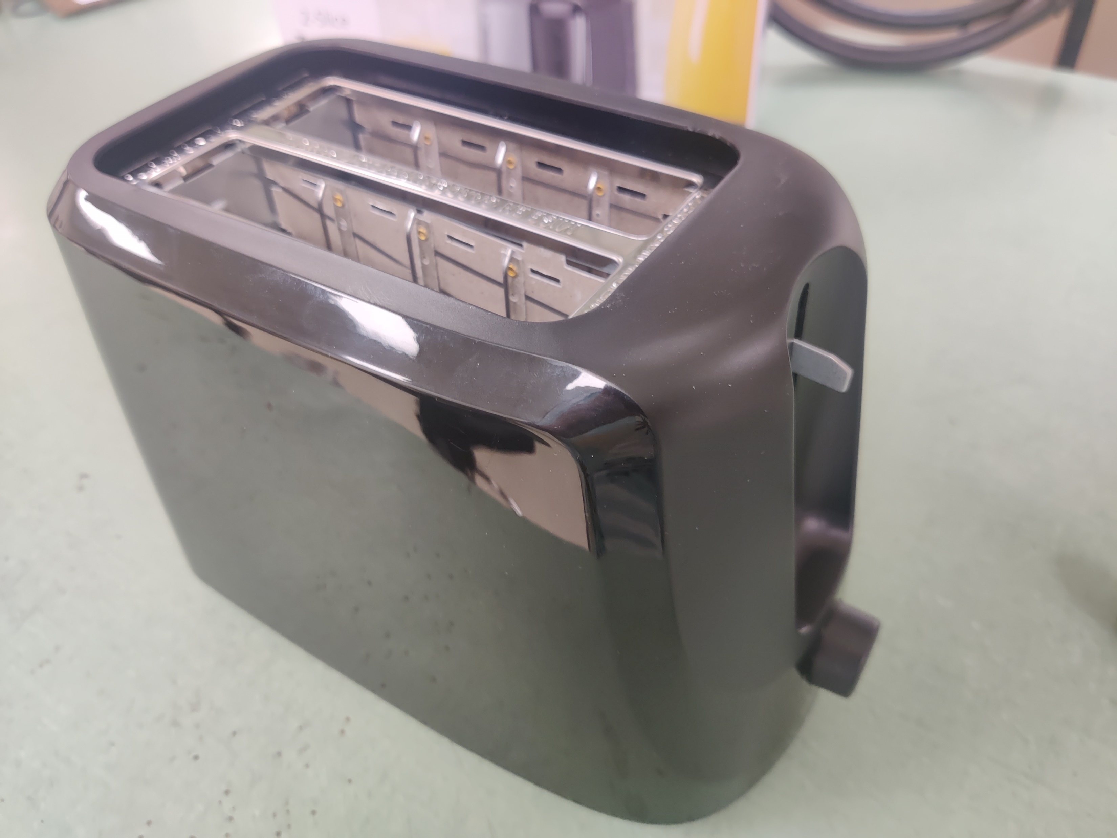
Toaster Teardown
Remove Knob
Notes:
Series of picture slides of the toaster tare down.

Slide 10
Toaster Teardown
Remove bottom screws
Notes:
Series of picture slides of the toaster tare down.

Slide 11
Toaster Teardown
Remove screw from PCB
Notes:
Series of picture slides of the toaster tare down.

Slide 12
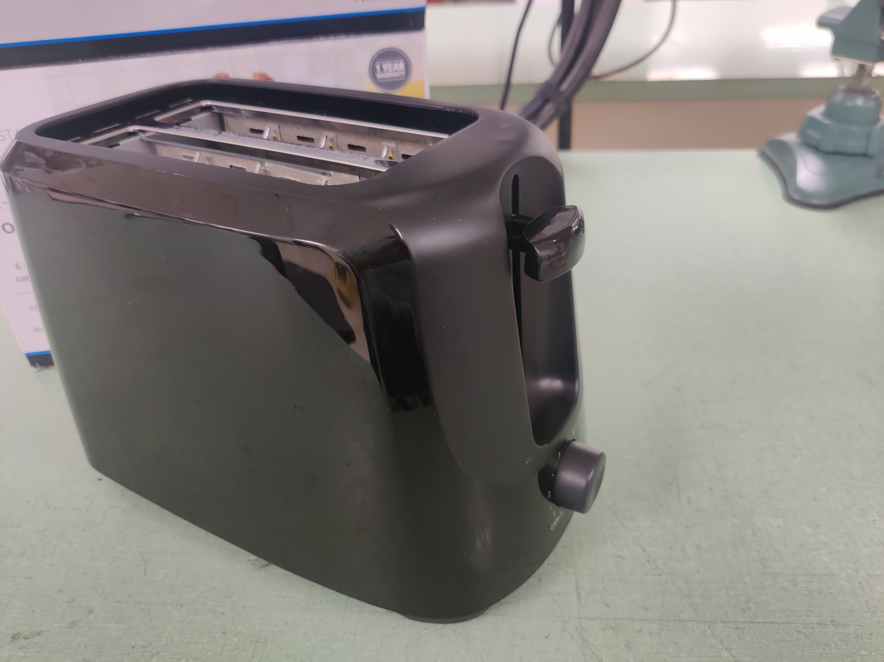
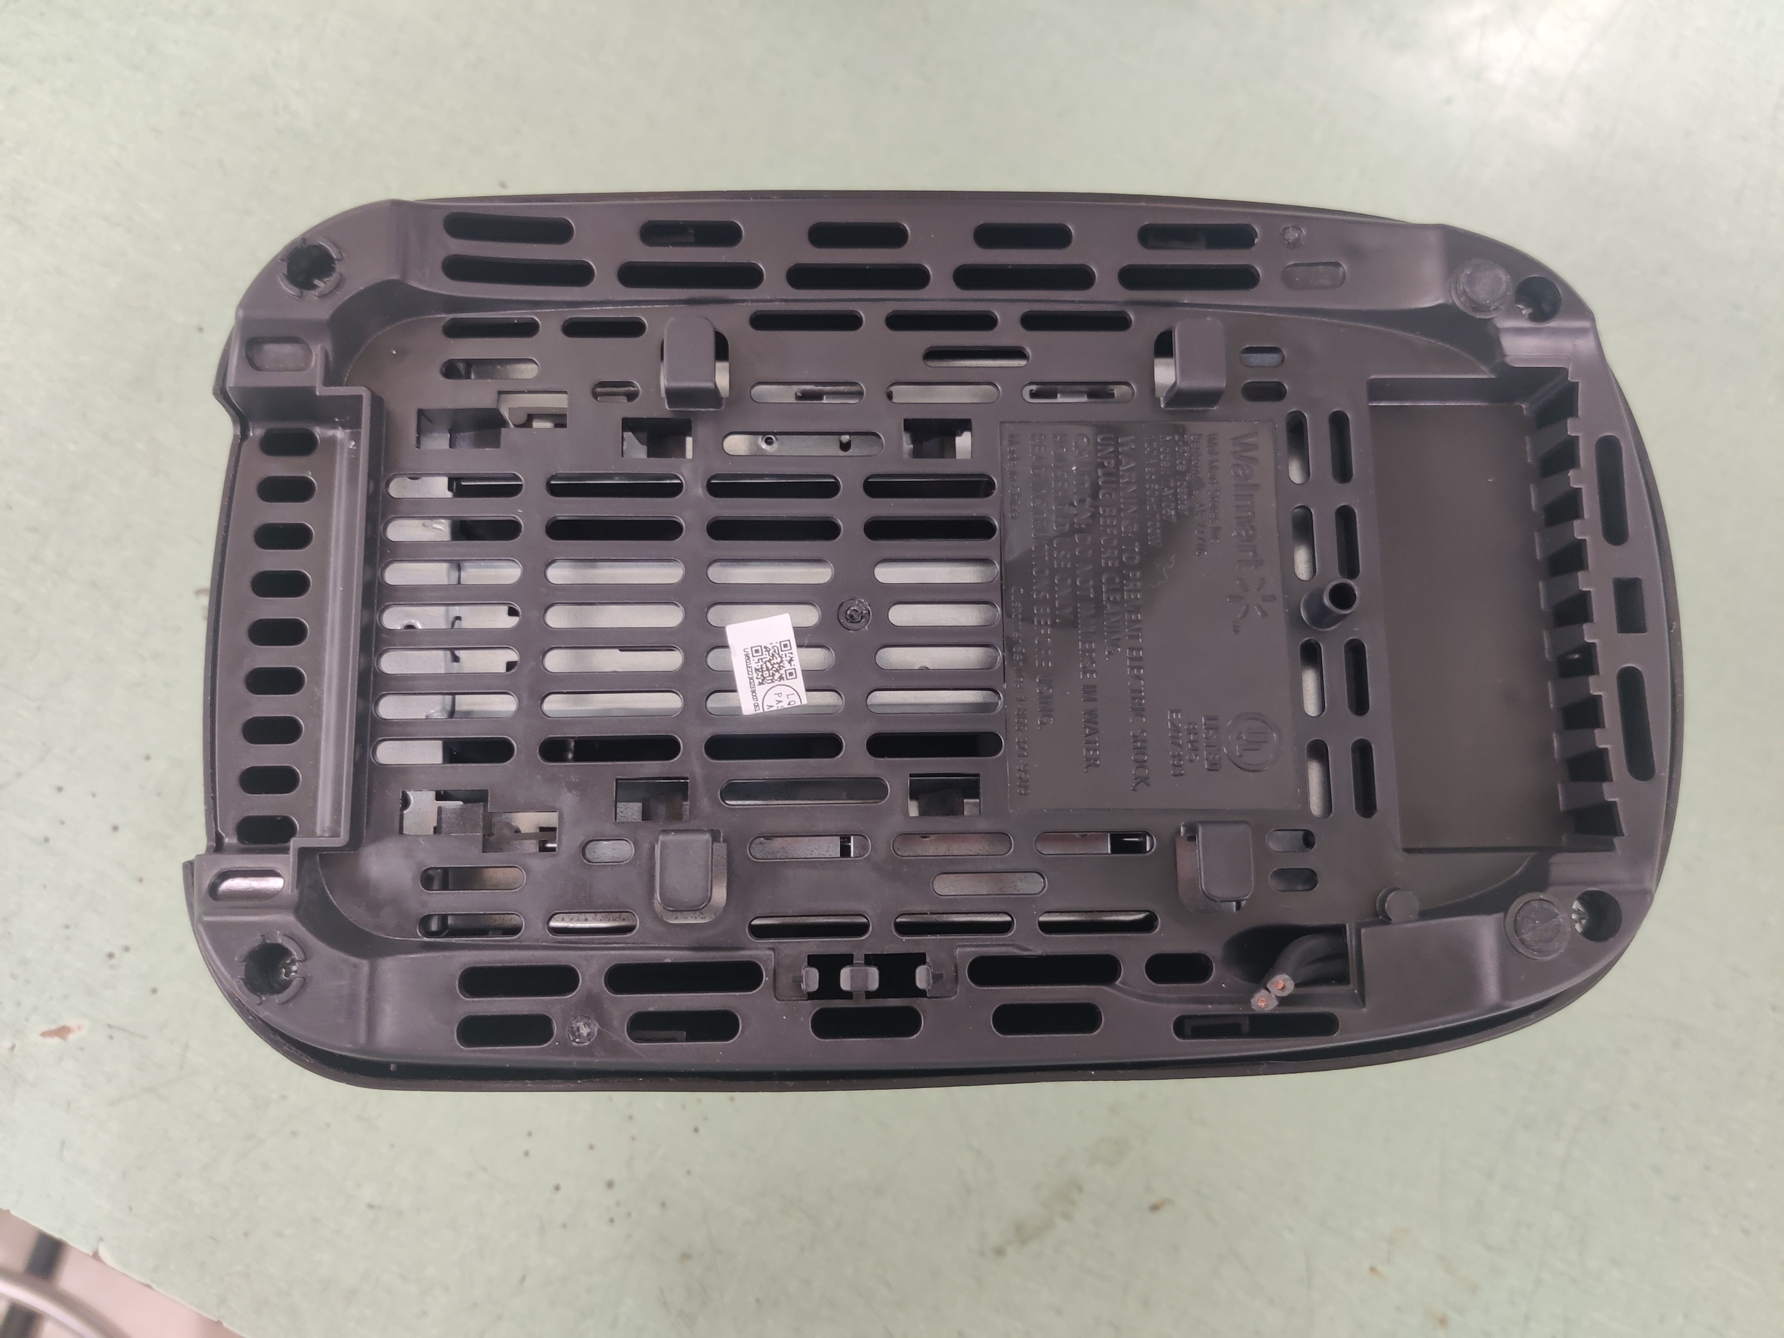
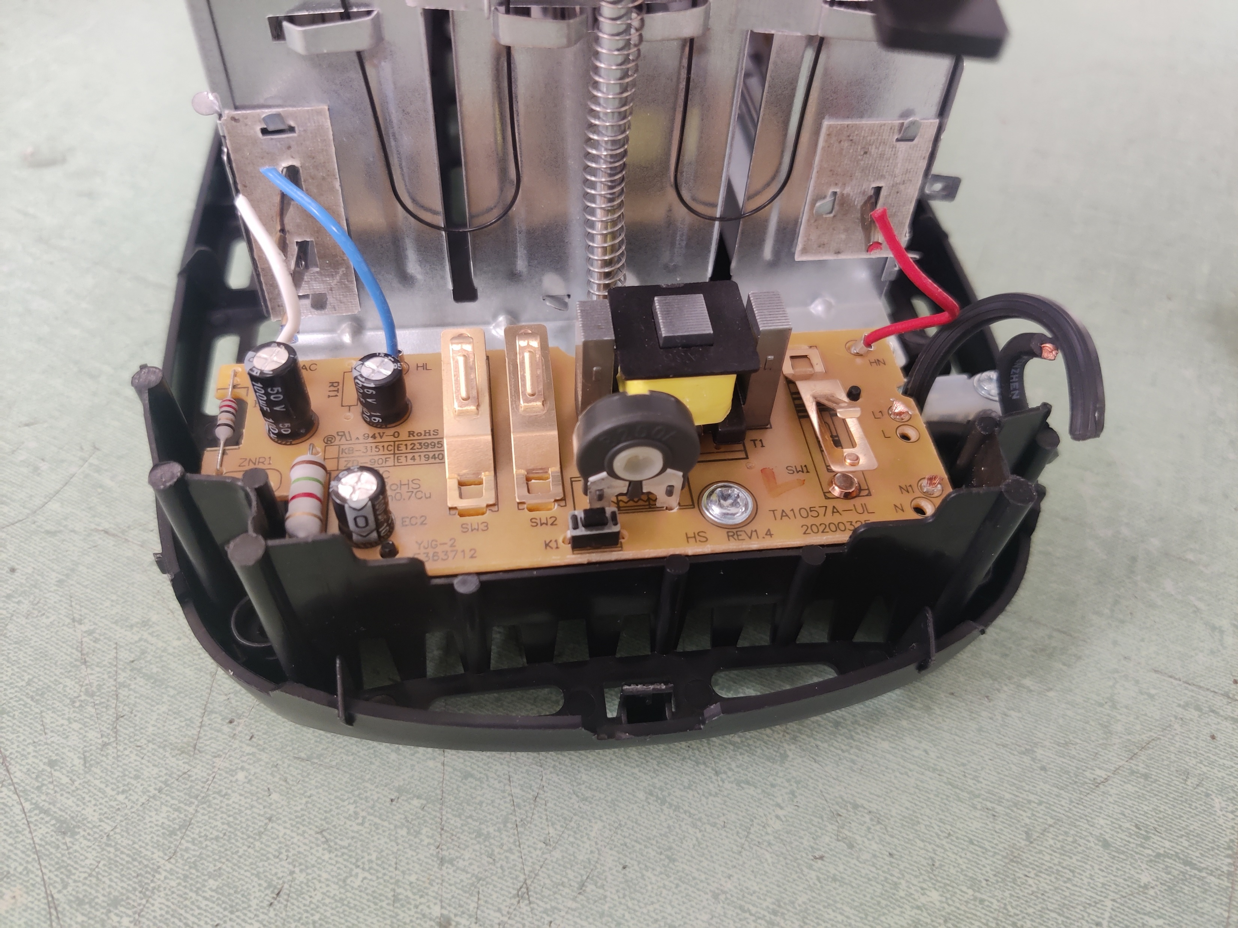
Toaster Teardown
Remove Knob
Remove screw from PCB
Remove bottom screws
Notes:
Series of picture slides of the toaster tare down.

Slide 13
Image Bibliography
https://www.theengineeringprojects.com/2018/01/introduction-to-resistors.html
https://learn.sparkfun.com/tutorials/transistors/extending-the-water-analogy
https://www.murata.com/en-global/products/capacitor/ceramiccapacitor
https://en.wikipedia.org/wiki/Electrolytic_capacitor
https://www.shutterstock.com/search/inductor-symbol
https://components101.com/articles/introduction-to-inductors
https://components101.com/articles/types-of-inductors-and-their-applications
https://www.autodesk.com/products/fusion-360/blog/diode-led-work/
https://learn.sparkfun.com/tutorials/integrated-circuits/all

